Slide 1
Internet of Things

Slide 2
Arsitektur IoT
Basic Technologies
IoT Simulation
Internet of Things

Slide 3
Arsitektur IoT
Network Layer
Content Layer
User interface devices (e.g. computer screens, PoS stations, tablets, smart glasses, smart surfaces)
Hardware: CPS, machines, sensors
Service Layer
Device Layer
Applications, software to analyze data and transform it into actionable information
Communications protocols, Wi-Fi, Bluetooth, LoRa, cellular

Slide 4
Arsitektur IOT
Arsitektur IOT : NODE
Sensors
Protocol
Wireless Link + Protocol
Server
Nodes
Gateway
Services
Nodes
Controller, Memory, Power Management

Slide 5
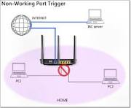
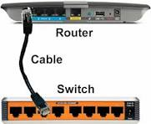
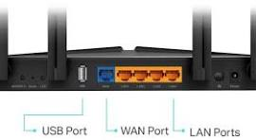
Arsitektur IOT : Gateway
BT Ethernet
Connect
Data Sensor
Data Pasien
Data GPS
………….
SMS
Ethernet
Next.. Devices
Ethernet Connect UK adalah layanan Ethernet Wide Area Network (WAN) lapisan 2 generasi berikutnya, adaptif, dan berkinerja tinggi

Slide 6
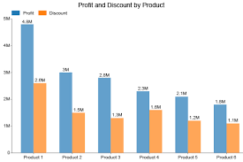
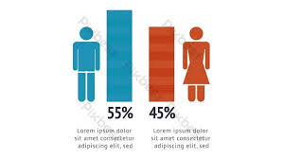
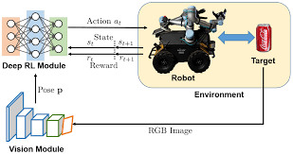
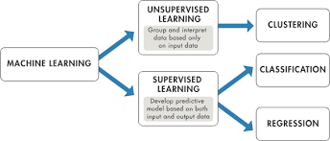
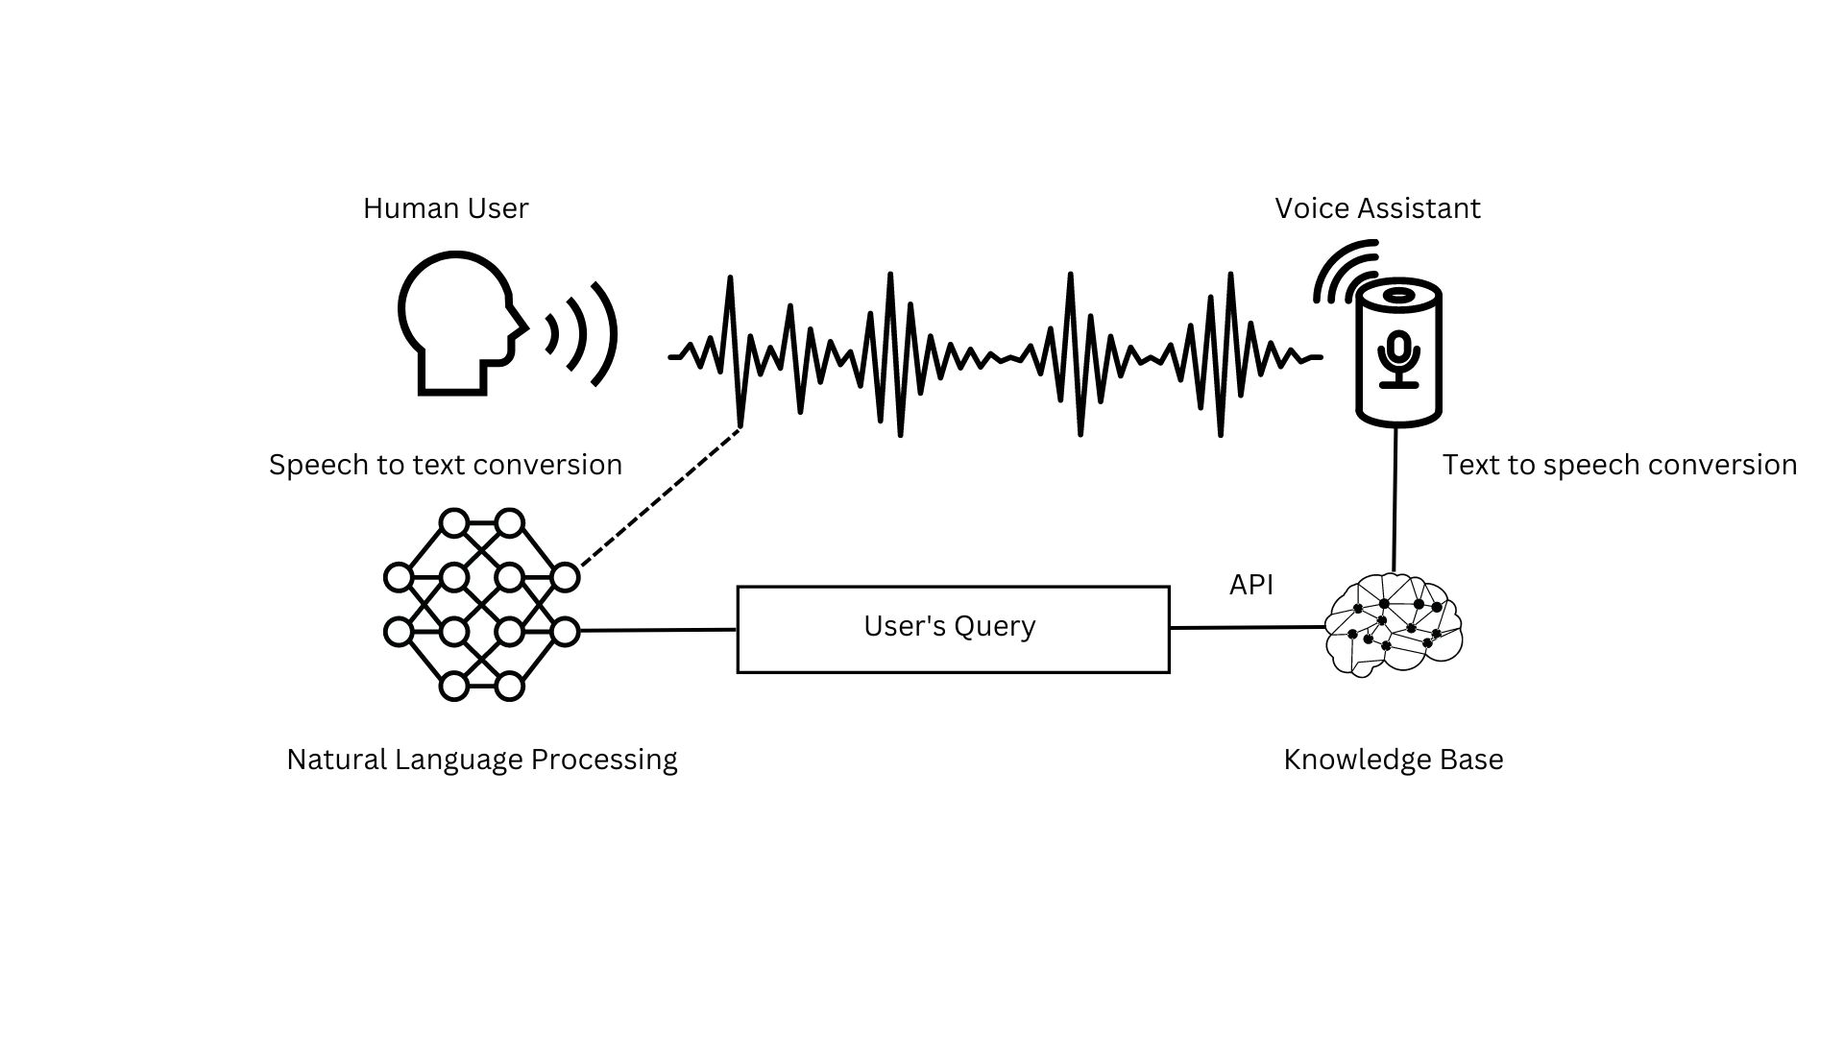

Arsitektur IOT : Services
Visualization Graph
Machine Learning
Alerting
Input
Storage,
Process
Output
Data Sensor
Data Pasien
Data GPS
………….
Dataset

Slide 7
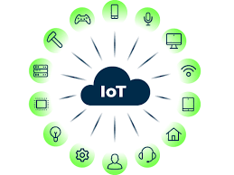
BASIC TECHNOLOGIES
Things
Data Analytics
Gateways/Cloud Gateways
Big Data Warehouse
Streaming Data Processor
Machine Learning
Data Lake
User Application

Slide 8
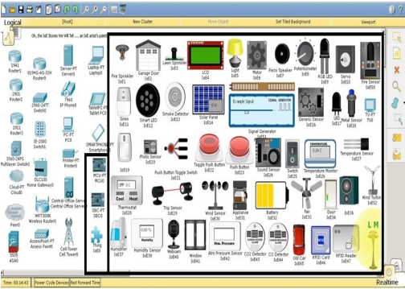
PACKET TRACER IOT SIMULATION

Slide 9
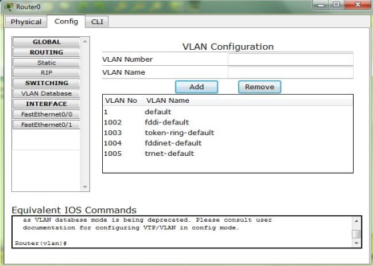
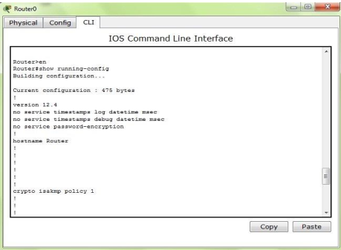
Packet Tracer DEVICE CONFIGURATION METHOD

Slide 10
Packet Tracer Protocols
Layer | Protocols
Application | FTP,SMTP, POP3, HTTP, TFTP, Telnet, SSH, DNS, DHCP, NTP, SNMP,AAA, ISR VOIP, SCCP config and calls ISR command support, Call Manager Express
Transport | TCP and UDP, TCP Nagle Algorithm & IP Fragmentation, RTP
Network | BGP, IPv4, ICMP, ARP, IPv6, ICMPv6, IPSec, RIPv1/ v2/ng, Multi Area OSPF, EIGRP, Static Routing, Route Redistribution, Multilayer Switching, L3 QoS, NAT, CBAL, Zone-based policy firewall and Intrusion Protection System on the ISR, GRE VPN, IPSec VPN
Network Access/ Interface | Interface Ethernet (802.3), 802.11, HDLC, Frame Relay, PPP, PPPoE, STP, RSTP, VTP, DTP, CDP, 802.1q, PAgP, L2 QoS, SLARP, Simple WEP, WPA, EAP

Slide 11
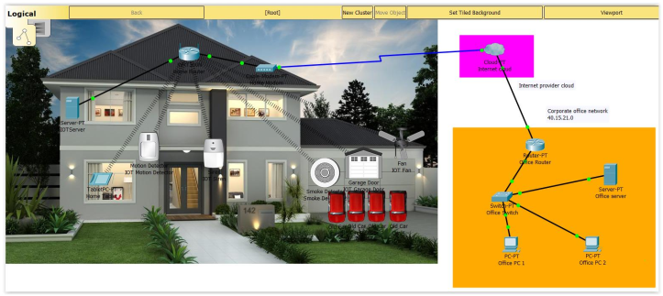
SMART HOME EXAMPLE

Slide 12
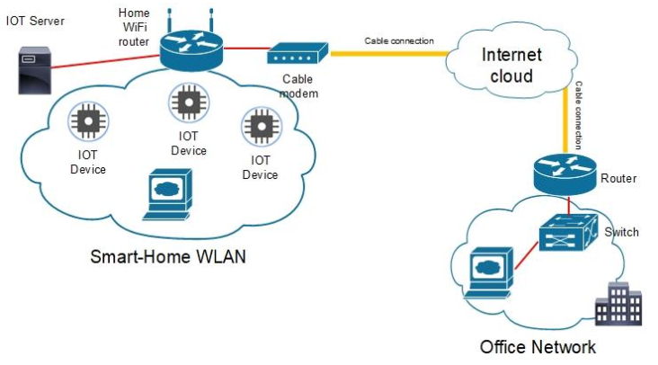
SMART HOME NETWORK TOPOLOGY

Slide 13
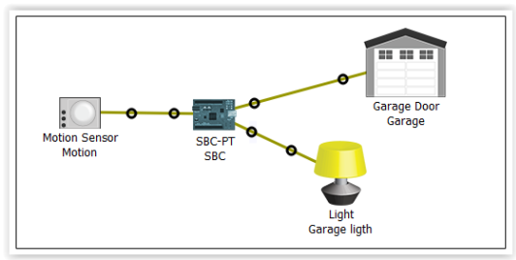
SMART HOME MICROCONTROLLER

Slide 14
EXercise
Jelaskan Cara Kerja Arsitektur IoT ! Disertai dengan bagan/skema/gambar
Buatlah simluasi IoT Smart Home sederhana menggunakan packet tracer. Contoh ada di video.
Alat yang digunakan : 2 Home device (usahakan berbeda dengan device yang ada di video), 1 Home Gateway, 1 Smartphone
Tugas 1 dan 2 dikerjakan di word. Untuk tugas no 2, Capture tiap langkah yang dikerjakan disertai penjelasan
Terdapat 2 file yang dikumpulkan :
File word hasil pengerjaan nomor 1 dan 2
File hasil simulasi di packet tracer (simulasi.pkt)
5. Semua file di jadikan 1 berbentuk rar/zip dan dikumpulkan dengan format :
IoT_namakelas_nim_nama
File di kumpulkan di github/Gd paling lambat tanggal .... Jam ....

Slide 15
Referensi
https://www.sciencedirect.com/journal/internet-of-things/vol/25/suppl/C
A smart IoT-based monitoring system in poultry farms using chicken behavioural analysis
In-cabin and outdoor environmental monitoring in vehicular scenarios with distributed computing
Managing a QoS-enabled Bluetooth Mesh network using a Digital Twin Network: An experimental evaluation
Sustainable collaboration: Federated learning for environmentally conscious forest fire classification in Green Internet of Things (IoT)
Notes:
https://internetofthingsagenda.techtarget.com/definition/Industrial-Internet-of-Things-IIoT
https://www.trendmicro.com/vinfo/us/security/definition/industrial-internet-of-things-iiot
https://www.i-scoop.eu/internet-of-things-iot/industrial-internet-things-iiot-saving-costs-innovation/
Yoo, Youngjin; Henfridsson, Ola; Lyytinen, Kalle (2010-12-01). "Research Commentary---The New Organizing Logic of Digital Innovation: An Agenda for Information Systems Research". Information Systems Research. 21 (4): 724–735. doi:10.1287/isre.1100.0322. ISSN 1526-5536.
https://www.iiot-center.org/

